Slide 1
CONDITIONAL STATEMENTS
and
CONTROL STATEMENTS
1

Slide 2
CONDITIONAL STATEMENTS (Decision Making) The basic decision statements in computer is
selection structure.
The decision is described to computer as a conditional statement that can be answered True or False.
Python language provide the following conditional (Decision making) statements.
➢if statement
➢if...else statement
➢if...elif...else staement
➢Nested if..else statement
2

Slide 3
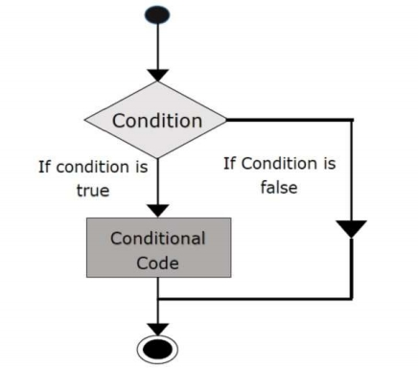
The if statement
The if statement is a decision making statement. It is used to control the flow of execution of the statements and also used to test logically whether the condition is true or false.
Syntax
if test expression:
statement(s)
3

Slide 4
Example program
i=int(input(“Enter the number:”)) If (i<=10):
print(“ condition is true”)
OUTPUT
Enter the number: 9
Condition is true
4

Slide 5
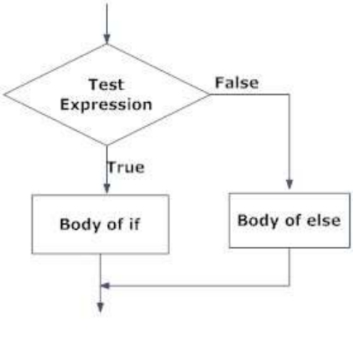
If … else statement
The if…else statement is called alternative execution, in which there are two possibilities and the condition determines wich one gets executed.
Syntax
if test expression:
Body of if
else:
Body of else
5

Slide 6
Write a program to check if a number is Odd or Even num = int(input(“Enter the number:”))
if (num % 2)== 0:
print (“Given number is Even”)
else:
print(“ Given number is Odd”)
OUTPUT
Enter the number: 9
Given number is Odd
6

Slide 7
elif Statements
❖ elif – is a keyword used in Python in replacement of else if to place another condition in the program. This is called chained conditional.  Chained conditions allows than two possibilities and need more than two branches. SYNTAX
if expression:
Body of if
elif expression:
Body of elif
else:
Body of else
7

Slide 8
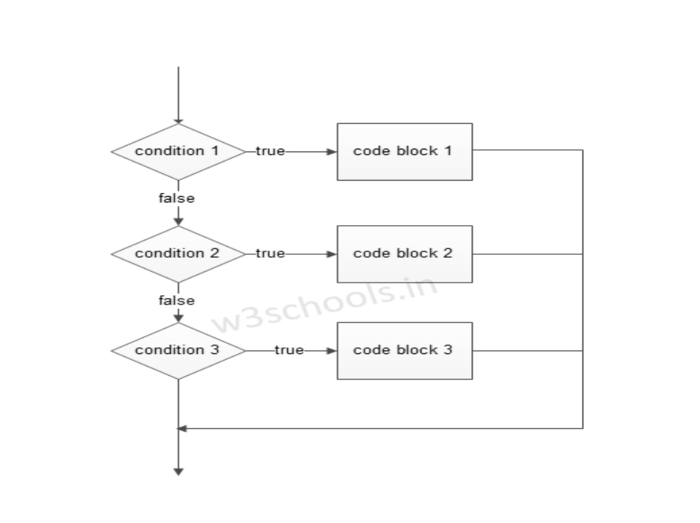
Figure – elif condition Flowchart
8

Slide 9
Example: largest among three numbers a = int(input(“Enter 1 number:”))
st
nd
b= int(input(“Enter 2 number:”))
rd
c= int(input(“Enter 3 number:”))
OUTPUT
Enter 1st number:10
Enter 2nd number:25
Enter 3rd number:15
B is greater
if (a > b) and (a > c):
print("a is greater")
elif (b < a) and (b < c):
print(“b is greater")
else:
print(“c is greater")
9

Slide 10
Nested if … else Statements
❖ We can write an entire if… else statement in another if… else statement called nesting, and the statement is called nested if.
❖ In a nested if construct, you can have an if … elif … else construct inside an if … elif.. Else construct.
10

Slide 11
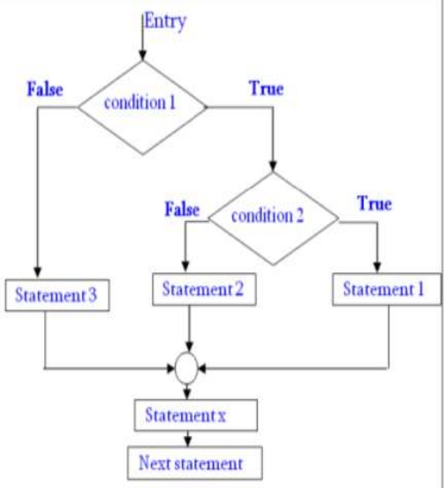
Syntax
if expression1:
statement(s)
if expression2:
statement(s)
elif expression3:
statement(s)
else:
statement(s)
.
11

Slide 12
• Example program
n = int(input(“Enter number:”)) If (n<=15):
if (n == 10):
OUTPUT
Enter number : 10
Play cricket
print(‘play cricket ’)
else:
print(‘play kabadi ’)
Else:
print(‘Don’t play game’)
12

Slide 13
CONTROL STATEMENT (Looping Statement)
Program statement are executed sequentially one after another. In some situations, a block of code needs of times.
These are repetitive program codes, the computers have to perform to complete tasks. The following are the loop structures available in python.
➢while statement
➢for loop statement
➢Nested loop staement
13

Slide 14
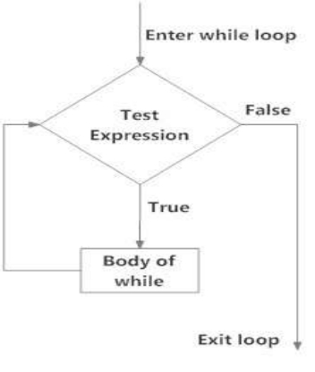
While loop statement
➢ A while loop statement in Python programming language repeatedly executes a target statement as long as a given condition is true.
Syntax of while loop
while expression:
statement(s)
14

Slide 15
Write a program to find sum of number num = int(input("Enter a number: ")) sum = 0
OUTPUT
Enter a number: 10
The sum is 55
while(num > 0):
sum = sum+num
num = num-1
print("The sum is",sum)
15

Slide 16
Using else statement with while loops
▪ Python supports t have an else statement associated with a loop statement.
▪ If the else statement is used with a while loop, the else statement is executed when the condition false.
Program to illustrate the else in while loop
counter = 0
while counter < 3:
OUTPUT
Inside loop
Inside loop
Inside loop
Outside loop
print("Inside loop")
counter = counter + 1
else:
print(“Outside loop")
16

Slide 17
For loop statement
The for loop is another repetitive control structure, and is used to execute a set of instructions repeatedly, until the condition becomes false.
The for loop in Python is used to iterate over a sequence (list, tuple, string) or other iterable objects. Iterating over a sequence is called traversal.
for val in sequence:
Body of for loop
Syntax
17

Slide 18
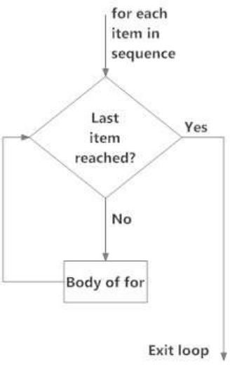
For loop flow chart
Addition of number using for loop numbers = [6, 5, 3, 8, 4, 2, 5, 4] sum1 = 0
for val in numbers:
sum1 = sum1+val
print("The sum is", sum1)
OUTPUT
The sum is 37
18

Slide 19
for Loop and for Loop with else EX-01:
OUTPUT
I like pop
I like rock
I like jazz
genre = ['pop', 'rock', 'jazz']
for i in range(len(genre)):
print("I like", genre[i])
EX-02:
genre = ['pop', 'rock', 'jazz']
OUTPUT
I like pop
I like rock
I like jazz
No items left.
for i in range(len(genre)):
print("I like", genre[i])
else:
print("No items left.")

